Slide 1










Slide 2








Loops are a part of C programming used to repeat a specific
block of code.
We need to repeat the a specific code for two reasons:
while
for
1- Repeat the code for defined number of iterations for ex: repeat a part of code for 10 times
In this case we usually use for loop
do while
2- Repeat the code until a certain event happens for: repeat a part of code until the user enter x
In this case we usually use while loop or do while loop
Loops in C

Slide 3
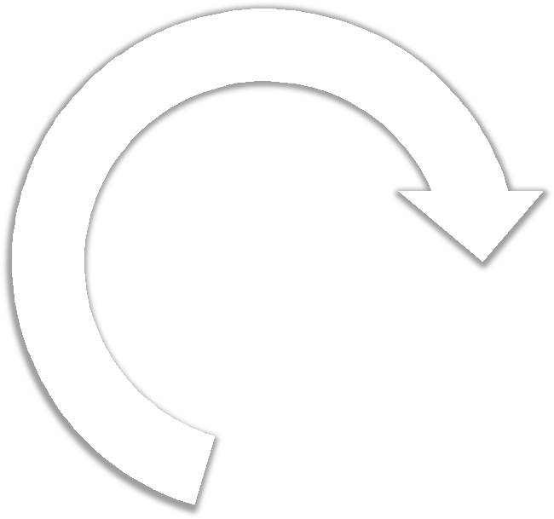
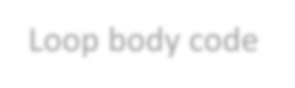

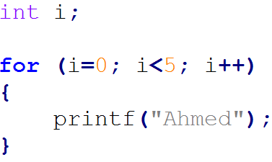
Used to apply the code for defined number of
iterations.
Apply this code for defined number of iterations
Syntax:
for ( start; condition; action )
{
loop body statements
}
Example
Loop body code
This loop will start initially @ i = 0 , each iteration it will increment i as said in the action, the loop will be applied as long as i is less than 5 as said in condition.
i.e. This loop will be applied 5 times

Slide 4







Expected Output
Write C code that will print your name 10 times

Slide 5



Expected Output
Write C print the first ten natural numbers

Slide 6

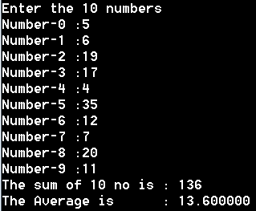



Expected Output
Write a program in C to read 10 numbers from the user and find their summation and average

Slide 7



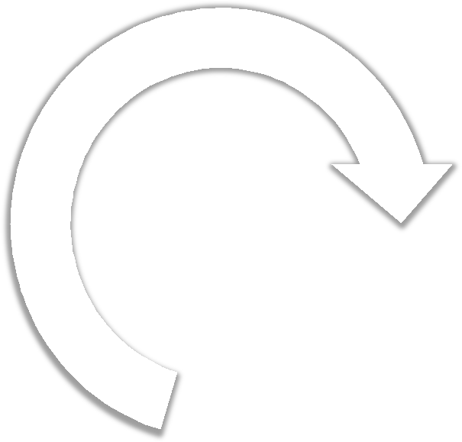

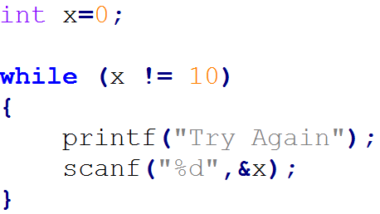
Used to apply the code as long as the
condition is true
Apply this code as long
as the condition is true
Syntax:
while ( condition )
{
loop body statements
}
Loop body code
Example
The code inside this loop will be repeated until the user enters 10, hence the condition will be false.

Slide 8




Expected Output
Write C code that ask will ask the user to enter the result of 3 x 4, In case the user entered correct answer the program will print Thanks, otherwise the program will print try again until the user enters the correct answer

Slide 9



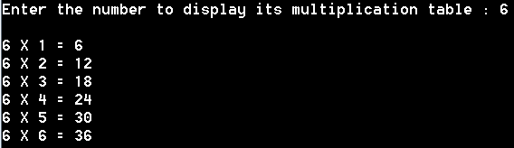
Expected Output
Write a program in C to display the multiplication table of a given integer.

Slide 10






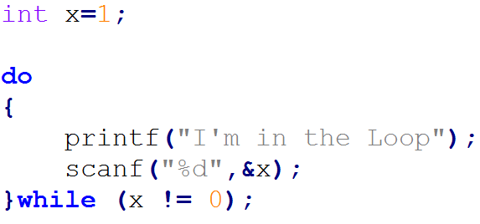
Apply the loop once then check the condition and repeat the loop as long as the condition is true.
Apply this code once then re- apply this code as long as the condition is true
Syntax:
do
{
loop body statements
Loop body code
} while ( condition );
Example
The string will be printed at least one time, then it will be repeated until the user enter 0

Slide 11




Expected Output
Write a program in C to calculate the factorial of an integer entered by the user using while loop

Slide 12



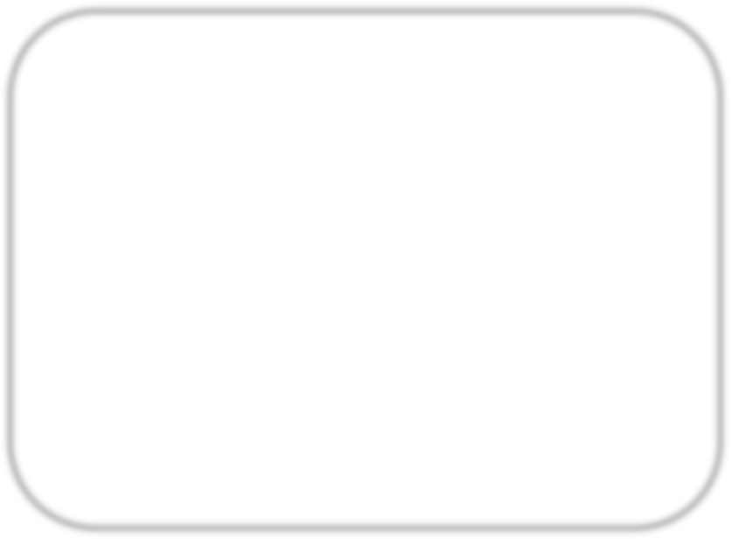

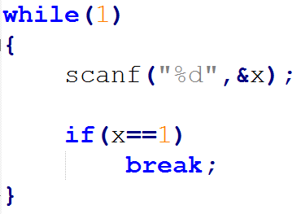
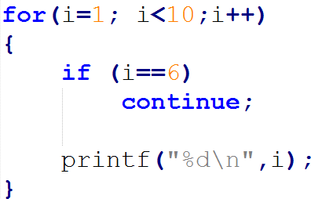
break statement can be used with the loop to exit the loop immediately and execute the outside code starting after the loop.
continue statement will skip the current iteration and jump to the next iteration
Example
Example
infinite loop
print all numbers from 1 to 9 except 6
break the loop in case the user enters 1

Slide 13
Any questions
… ?

Slide 14

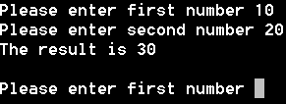
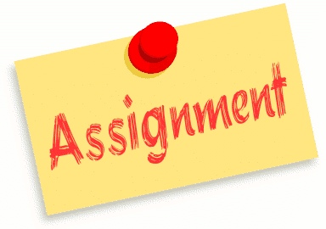
Expected Output
Write a C program that ask the user to enter two numbers and print their summation, this program should never ends until the user close the window

Slide 15





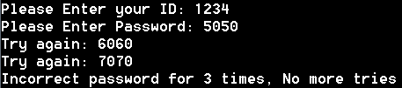
Expected Output
Write a login program in C that ask the user to enter his ID and his password, if the ID is correct the system will ask the user to enter his password up to 3 times, if he enters the password right the systems welcomes him, if the three times are incorrect, the system print No more tries. If the user ID is incorrect the system print You are not registered
User | ID | Password
Ahmed | 1234 | 7788
Amr | 5678 | 5566
Wael | 9870 | 1122

Slide 16

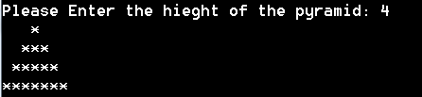
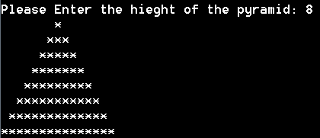
Expected Output
Write a c program that draw a pyramid of
stars with height entered by the user

Slide 17
Thank you

